Slide 1

Apostrophes and Commas
May 2016
Kindly contributed by Julie Hobson, TEAM Wearside.
Search for Julie on www.skillsworkshop.org and visit the download page for this resource to find a related Word document, and further links.
Curriculum links
Underpins several aspects of Functional English / Adult literacy (writing) at Entry 3, Level 1, Level 2.
Notes:
May 2016
Kindly contributed to www.skillsworkshop.org by Julie Hobson

Slide 2
Apostrophes
Omissive – could’ve
Possessive – Julie’s pen
Its versus it’s
Notes:
May 2016
Kindly contributed to www.skillsworkshop.org by Julie Hobson

Slide 3
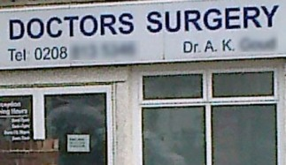
Notes:
May 2016
Kindly contributed to www.skillsworkshop.org by Julie Hobson

Slide 4
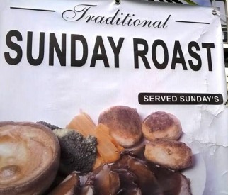
Notes:
May 2016
Kindly contributed to www.skillsworkshop.org by Julie Hobson

Slide 5
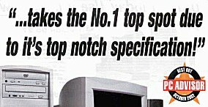
Notes:
May 2016
Kindly contributed to www.skillsworkshop.org by Julie Hobson

Slide 6
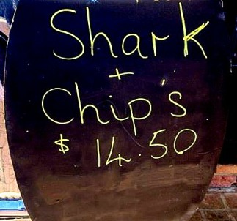
Notes:
May 2016
Kindly contributed to www.skillsworkshop.org by Julie Hobson

Slide 7

Notes:
May 2016
Kindly contributed to www.skillsworkshop.org by Julie Hobson

Slide 8
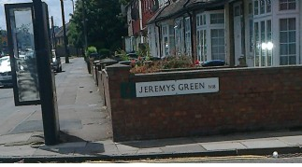
Notes:
May 2016
Kindly contributed to www.skillsworkshop.org by Julie Hobson

Slide 9

Notes:
May 2016
Kindly contributed to www.skillsworkshop.org by Julie Hobson

Slide 10
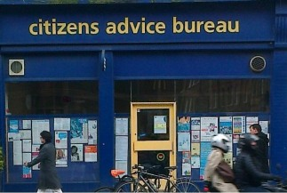
Notes:
May 2016
Kindly contributed to www.skillsworkshop.org by Julie Hobson

Slide 11
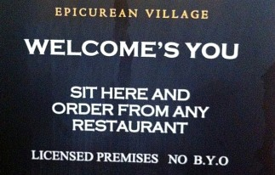
Notes:
May 2016
Kindly contributed to www.skillsworkshop.org by Julie Hobson

Slide 12

Notes:
May 2016
Kindly contributed to www.skillsworkshop.org by Julie Hobson

Slide 13
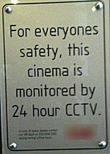
Notes:
May 2016
Kindly contributed to www.skillsworkshop.org by Julie Hobson

Slide 14
Commas
Why are they important?
Notes:
May 2016
Kindly contributed to www.skillsworkshop.org by Julie Hobson

Slide 15
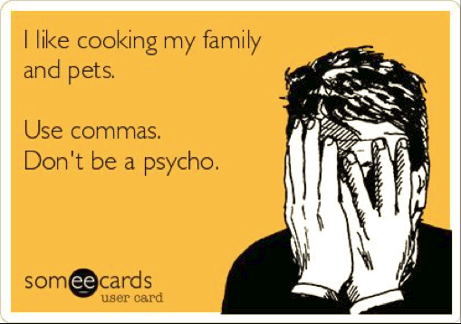
Notes:
May 2016
Kindly contributed to www.skillsworkshop.org by Julie Hobson

Slide 16
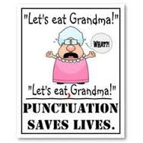
Notes:
May 2016
Kindly contributed to www.skillsworkshop.org by Julie Hobson

Slide 17
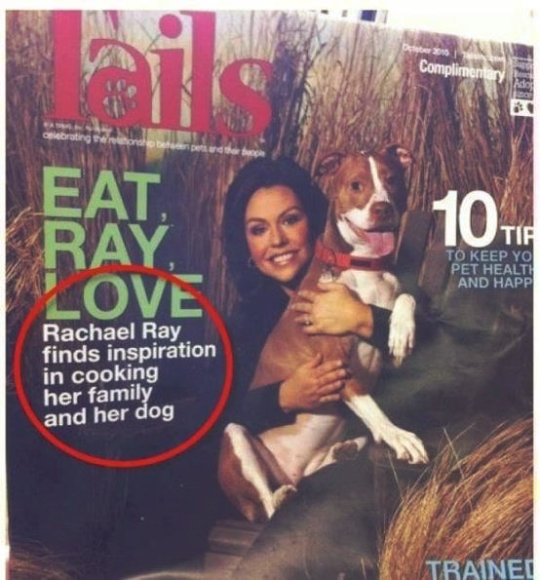
Notes:
May 2016
Kindly contributed to www.skillsworkshop.org by Julie Hobson

Slide 18
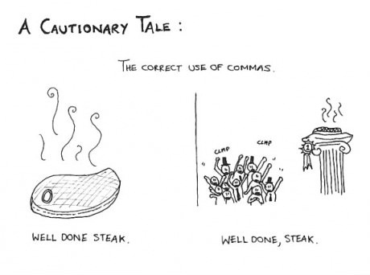
Notes:
May 2016
Kindly contributed to www.skillsworkshop.org by Julie Hobson

